Slide 1


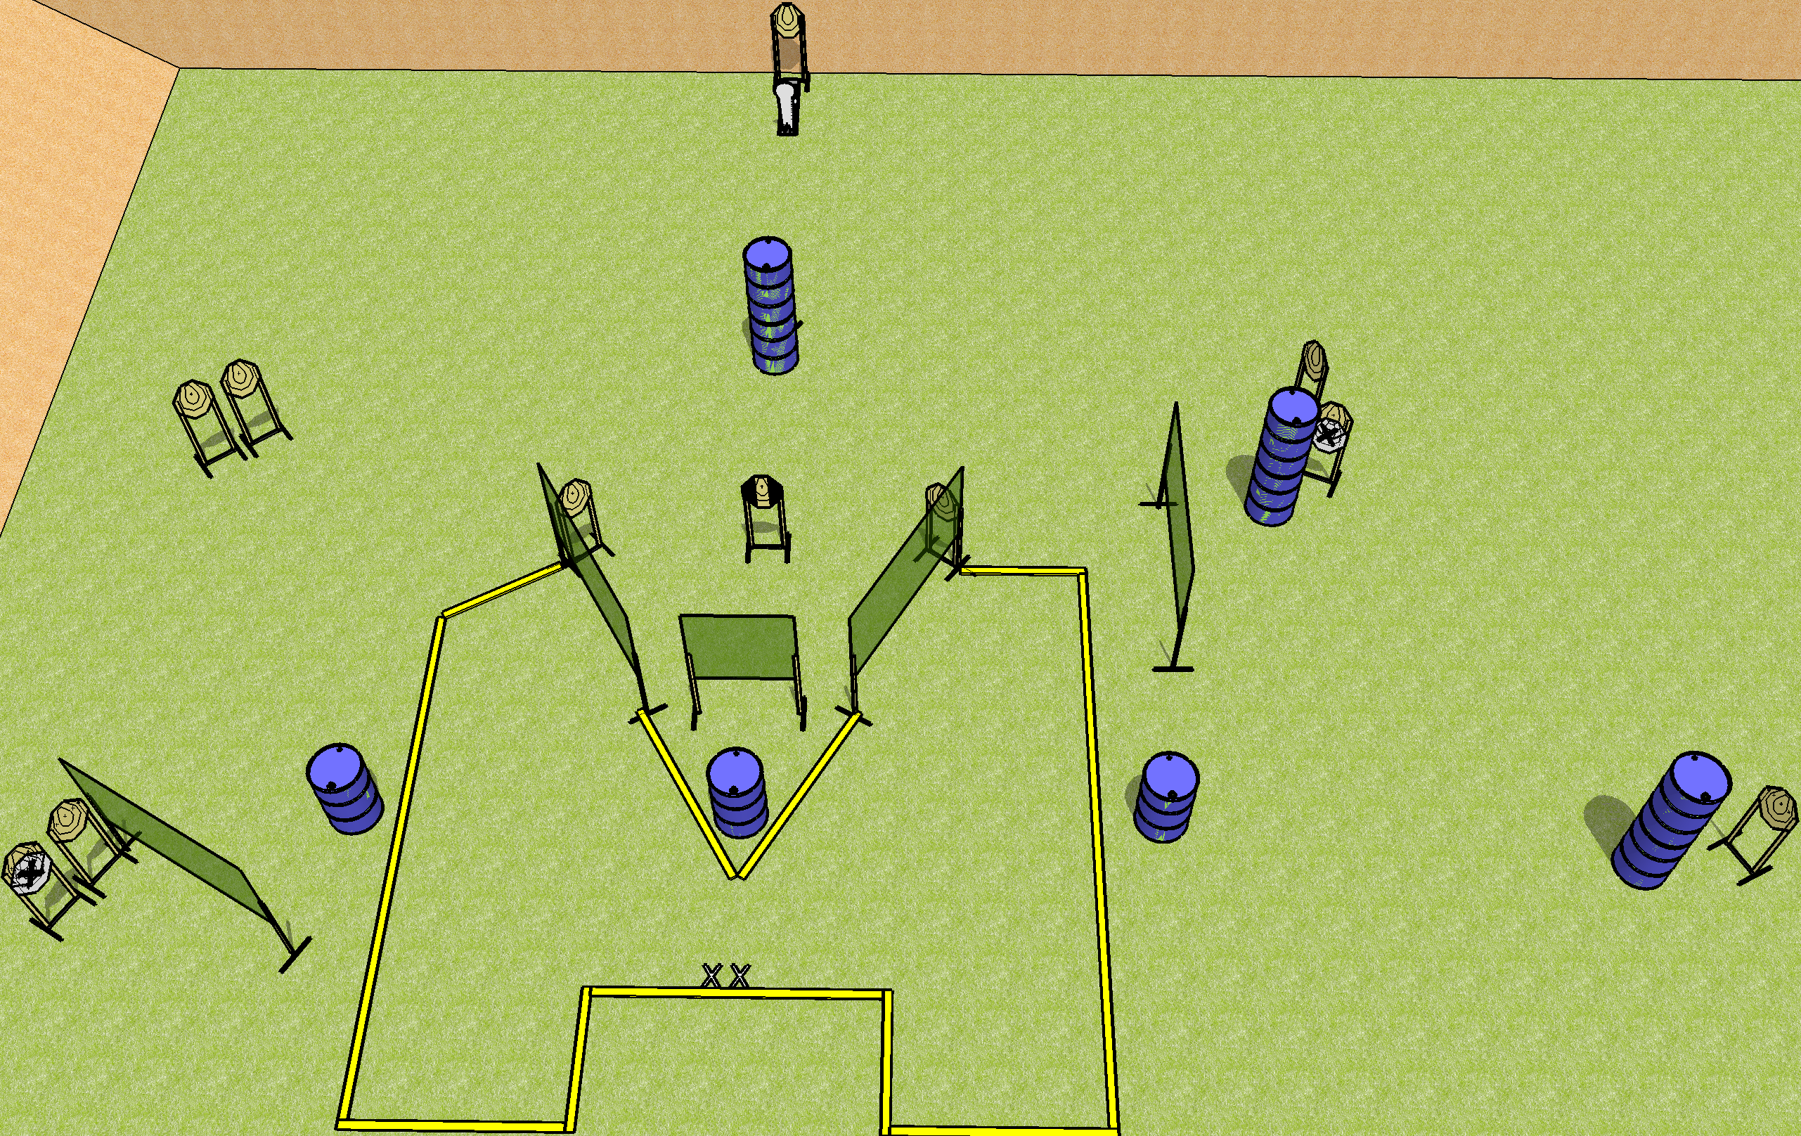
 | Dothan Gun Club – USPSA Match Funny Looking Course Designer : Drew Coleman
Round Count 25 rounds 12 IPSC 1 colt popper
Equipment List 10 wall feet 6 medium fault lines and 1 8’ fault line for the center near the X’s 1 tuxedo, 1 half

Slide 2
Funny Looking
Written Stage Briefing
Funny Looking is a 25 round, 125 point, Comstock course of fire. There are 12 IPSC targets and 1 Colt popper. The best 2 hits on paper will score, and steel must fall to score. The start signal is audible.
Handgun start position is heels on X’s, wrists below belt. Handgun is UNLOADED and holstered.
PCC start position is heels on X’s, stock on belt. Carbine is UNLOADED.
All magazines to be used on stage must start on barrels.
On start signal, engage targets as they become available from within the shooting area.

